Slide 1


Core Java
TEST AUTOMATION USING SELENIUM WEBDRIVER WITH CORE JAVA

Slide 2

I don’t have any prior programming experience and I am afraid of coding or I am not from computer background?
Does it really requires me to learn Java? to learn
Selenium

Slide 3
Yes But only the basics and the concepts which is required for selenium will be covered in depth and in easy manner……

Slide 4

What will be That?
Introduction to Java.
Basics of Java programming to get started.
Loops and decision making concepts in Java.
Oops concepts: There are only 4 major oops concepts required not to worry.
And
Little bit of collection concepts
So lets get started

Slide 5
Introduction to Java
Java is the high level programming language. (High level means the program written in English language or human understandable language).
Java was introduced by Sun micro system and now it’s been taken over and owned by Oracle.
Java evolution began in early 1994 and James gosling is called father or java language.
Java started with the version 1.0 and the latest as on today its 9 as on 7/10/2018. But preferably use 1.8.
Java is also know as object oriented programming language.

Slide 6
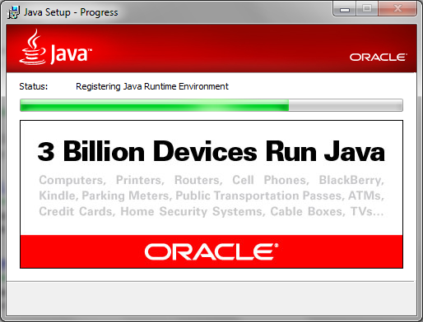
Advantages of using java
Now a days Java can be found on anything and everything from your mobile phone, computer till the appliance used in kitchen.
Java programs developed using windows machine can run or mac or Linux without any problems.

Slide 7
What are OBJECTS in Java?
Object is any real world entity which has state and behavior.
Example lets consider Car as an object.
So its state can be “Color” and “Make” and
Behavior of the car is the Car can move, Car engine can make noise.
But what's Object in java programs refer to?.
Any elements in the application is called as objects of that application.
Ex: In a webpage there will be multiple elements like text box, image and button.

Slide 8
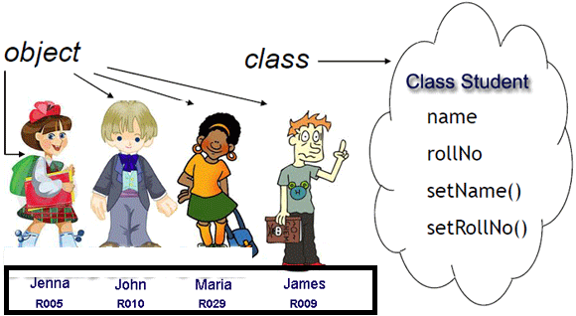
What are Class and Packages Java?
Collections of similar kind of objects and wrapping it together is known as class.
Packages are nothing but folders containing similar kinds of classes.

Slide 9
LETS GETS STARTED WITH THE SOME EXAMPLES

